Slide 1
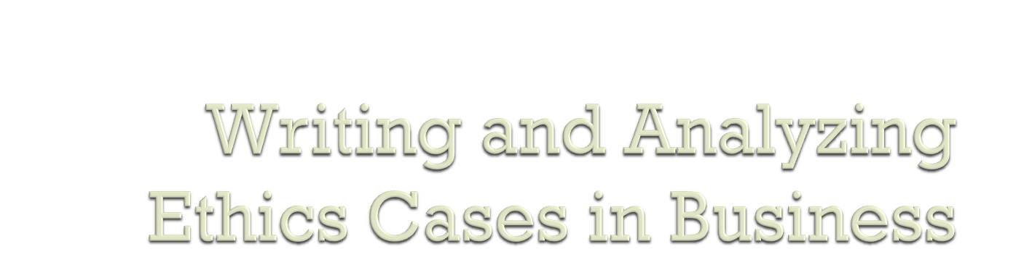
William Frey
ADMI 6005

Slide 2

A Case Taxonomy
How to choose your case
A template for writing and analyzing your case
Poster Presentations: a proposal

Slide 3

onlineethics.org
  Killer Robot Case
  APPE cases in graduate research ethics
computingcases.org
  Therac-25
  Hughes Aircraft
  Machado
uprm.edu/etica

Slide 4

Thick vs. Thin
  Thin cases are useful for abstracting a single point and focusing work on that point.
  Thick cases can give the student practice in making ethical decisions in the full context of the messy real world.
Historical vs. Hypothetical
  Based in actual experience in the field.
  These provide the sort of excitement and immediate relevance that help students recognize the importance of ethical enquiry.
  Cases that are hypothetical, fictional, or abstract remove much of the impact of the historical case, though they allow the case writer the freedom to structure, abstract, and focus the discussion on precisely the issues of concern.

Slide 5
Good vs. Bad News cases
  The tendency in ethics cases is to have only bad news cases, cases in which some bad outcome occurs because of poor choices.
  This can grab students’ imaginations (people are highly motivated to avoid bad outcomes) but can also give students the impression that business and research ethics is primarily about avoiding harm.
  Bad news cases should be balanced with cases of morally exemplary scientists and engineers as well as with good choices toward good outcomes made by ordinary scientists and engineers.

Slide 6
Big vs. Small News cases
  Many cases available are about big news, about things that show up in the newspaper.
  These are rare events, and it can be hard for students to imagine themselves caught in a widespread fraud or catastrophic software safety case.
  Small news cases are about the everyday decisions that scientists and engineers make in the way they handle reporting, data collection, process management, personnel and other day-to-day issues.
  Students can more easily imagine this happening to them, but the cases can be about less exciting issues.

Slide 7

PARTICIPANT
EVALUATOR
Student takes on the role of one of the participants and makes a decision from that perspective
Help students to practice integrating ethical considerations into designing and implementing solutions to real world problems;
Allow practice making decisions under real world constraints such as uncertainty and time pressures
Student takes up a standpoint from outside the case and evaluates the participants and their deeds.
Useful for introducing and practicing different ethical principles and concepts
Useful for introducing and practicing different ethical principles and concepts

Slide 8

An Example: Aquaculture Case from NSF SBR-9810253
Original version: A local aquaculture facility near Ponce was closed by the EPA for violating environmental standards. The EPA claimed they shot birds from endangered species (because the birds were eating the crop, e.g., lobster fingerlings) and also that they dumped untreated waste water into the local river.
Question: Was the EPA just or unjust in closing the facility?
Notes:
Assumptions in writing the case:
Evaluator’s point of view
Events of the case are closed; the consequences have occurred.
The role of the analyzer is to evaluate the actions taken which results in pinning a moral label on these.
The role of conflicting constraints and uncertainty that influenced the decision from the participant point of view are covered over.

Slide 9
The students rewrote this case:
The EPA has informed an aquaculture facility that they are in violation of environmental regulations (shooting endangered birds and improper disposal of waste water). This facility has two months to submit a compliance report. To write this report, they have hired a group of engineers as consultants. You are one of the consultants. Your job is to write a report that describes several possible compliance responses. Include information on how to implement these responses and their costs.
Notes:
The students asked to rewrite the case because they felt the other version was too constraining.
They were apologetic in gaining permission because the second version elicits a technical as well as ethical response. Their concern was whether working on technical solutions to the aquaculture facilities problems was a violation of the assignment which wanted an ethical analysis. They feared that I assumed that an ethical solution excludes a technical solution.

Slide 10

It places the analyzer in the participatory point of view, rather than that of the evaluator.
It elicits a decision that integrates technical and ethical components; it is interdisciplinary
Business skills and knowledge are required to formulate the ethical problem.
It elicits a proactive rather than a reactive, judgmental response.

Slide 11

Write several scenarios
Choose one of these scenarios
Identify paths for developing this scenario into a case that involves business, research, and ethical issues
Develop a case study and analysis
  According to template carried out in Toysmart case
  Prepare a poster presentation for May 1.

Slide 12

Ties to your areas of interest and research
Case raises an ethical issue
  How to mitigate or prevent harm
  How to resolve conflicts between ethical and financial value
  How to balance and respect the rights of different stakeholders
  How to transform a dysfunctional corporate environment into an ethical organization
Case is based on information that is readily accessible
  Importance of building case around its socio-technical system
Case interests and engages you. You and your group would find the time spent preparing it to be well spent.

Slide 13

Toysmart involves ethical issues
  Privacy: Should the Toysmart customer data base be sold to a third party against Toysmart’s explicit promise?
  Intellectual Property: We generate personal information such as TGI. Is this personal information private? Under what conditions? Do I own it, i.e., is it my property?
How does the fact that this drama takes place in a “cyber stage” transform the key issues like keeping promises, honoring privacy, and protecting intellectual property?

Slide 14

Abstract
  Provides a quick entry into the case. This might be very much like your beginning scenario
Historical Narrative
  Here, in about 5 to 10 pages you try to detail the “story” of your case. Elements of a narrative include a beginning, a middle point, and an end. Narratives have protagonists, antagonists, and other participants. Protagonists confront challenges and do different things to meet them.
Socio-Technical System
  The case narrative unfolds in a particular STS
  This STS embodies certain values (moral and non-moral) that come into conflict and create the drama that unfolds in the case’s narrative.

Slide 15
Key elements of the STS
  Stakeholders
    People and groups that have vital interests
    The roles they play.
    Conflicts that arise from differences and incompatibilities in stakeholder interests
  Legal Trail
    A chart exploring important laws, statutes, and regulations that form part of the constraints of your case
  Procedures
    Organizational Structures. In Toysmart, how customers went to Toysmart’s webpage, found toys, purchased them.
  Information Structures: how Toysmart collected, stored, used, and transferred information

Slide 16

What happened in your case? In what order?
  A chronology is one way to explore a case narrative
  A good chronology also helps you to identify information gaps.
Who are the major players in your case?
  Get this from the stakeholder part of the STS

Slide 17

Cases unfold according to the decisions made in key points in the narrative. The decision makers and what they do form participant perspectives
Toysmart: Fateful decisions
  Lord decides to go with Disney financing
  Toysmart uses its corporate value structure to help it develop a privacy policy. (This leads to working with TRUSTe)
  TRUSTe takes a hit in the real player case. This leads to a decisive altering in its monitoring of those using its seal
Decisions made in liquidating Toysmart assets in bankruptcy proceedings
  Whether to sell customer data base
  How to sell the data base (Opt in or opt out)
Choose a decision point and take a decision
  Specify problem
  Generate solutions
  Test solutions
  Implement solutions

Slide 18

These are explorations of some of the complications surrounding key intermediate moral concepts in the case
  Biomatrix—Free Speech
    Defamation: slander and libel
    Responsibility of OSPs (As publishers, distributers or common carriers)
    Key point in Biomatrix: exploration of actions of BXM Police under Bandura’s schema for evading responsibility
  Toysmart—Intellectual Property and Privacy
    How the Internet transforms property and privacy
    Cyber Corporation (History of corporation and how the Internet transforms these)
    Cyber Jeeves (Software that negotiates with other software for terms for exchanging information—Configuring software/browsers with your privacy preferences)
  Machado—Free Speech and Privacy
    Looking at how a STS instruments different kinds of actions and decisions

Slide 19

Lecture + Workshop
April 3
  Research Program in Moral Psychology
    Moral Exemplars / Good Works
April 10
  Moral Psychology (4-component model and how this translates into a research program in Business Ethics)
April 17
  Pedagogical Challenges (Responding through EAC and the Toolkit)
April 24
  Moral Ecologies in Puerto Rico (Engineering and Business)

Slide 20

May 1:
  Group Poster Presentations
May 8
  Custom designates this as the final exam date and time
  Turn in Group Cases and Analyses
Rubric for Posters and Presentations
Rubric for Cases and Analyses

